Slide 1
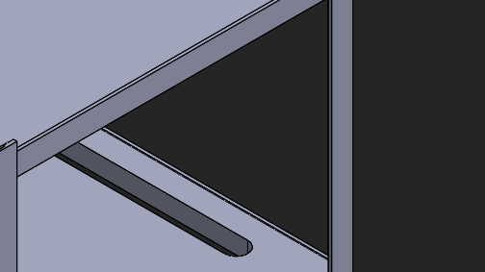
3D Printer Shelf
AmongUs

Slide 2
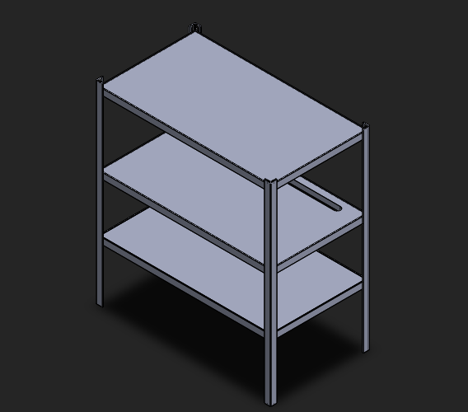
Overview:
Adjustable height
Durability
Cost efficient
Long term use

Slide 3
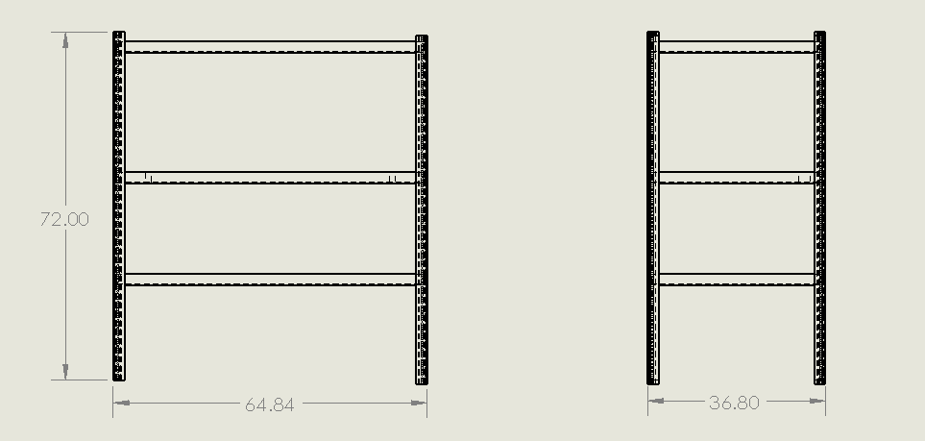

Slide 4
Capability
Able to hold up to 4 lulzbot mini per shelf ( no dehumidifier included )
Weight restriction: N/A

Slide 5
Support Rail
Galvanized steel L-shape rails inner
Outer support plank

Slide 6
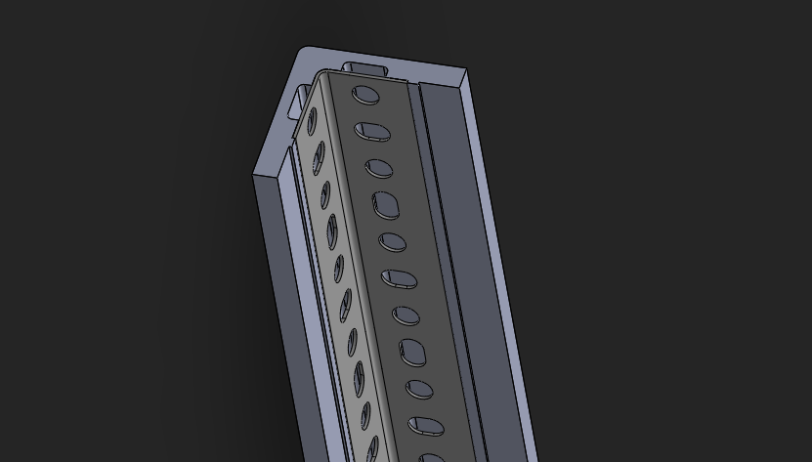
Plank/Plastic outer support part
Galvanized Steel L-shape Rail.
Support rail assembly

Slide 7
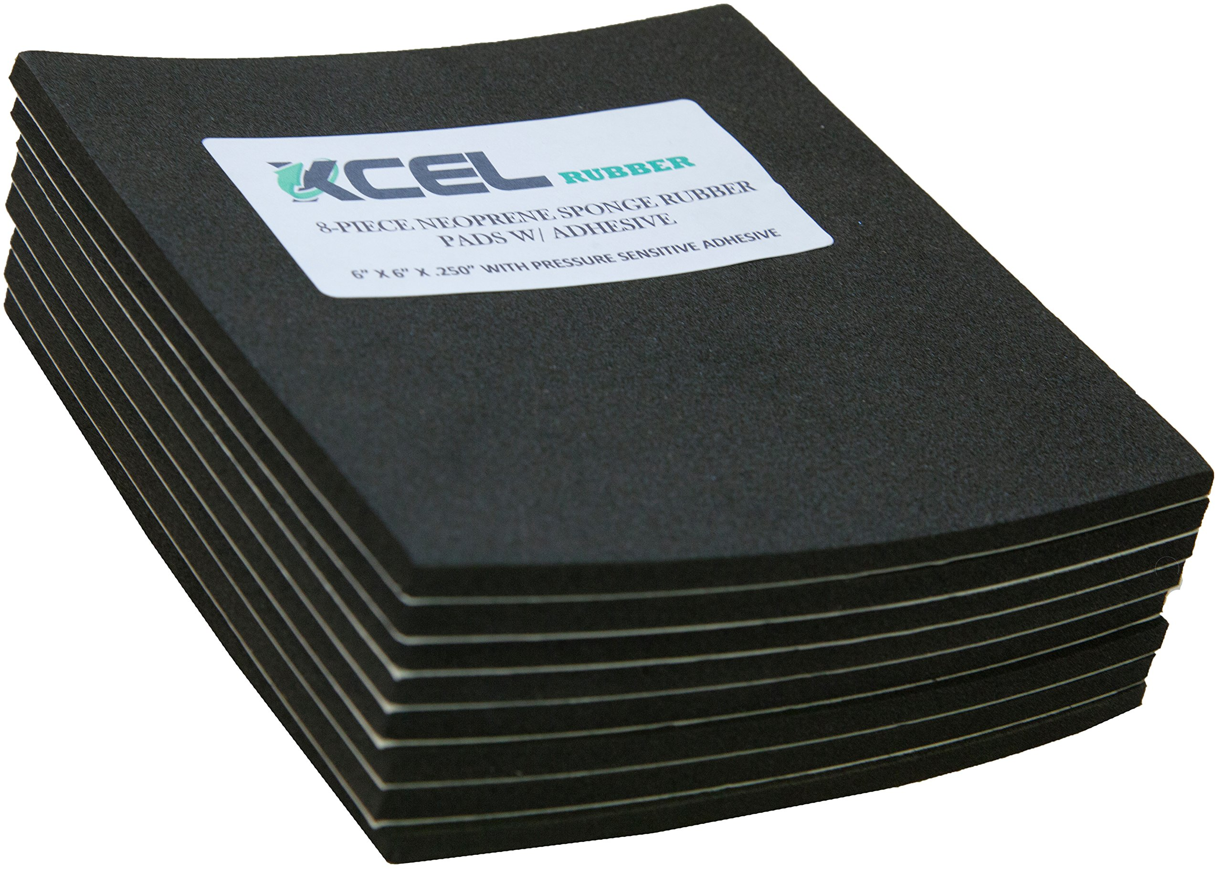
Printer Holder/ Vibration Dampener
This part work as both holder to hold the printer in place and a vibration dampener system because from my experience, the printer will vibrate while printing because of the stepper motor movement and can sometimes be annoying.
In order to decrease the vibration, the holder has the area to add anti-vibration foam. Simple mechanic but underrated.

Slide 8
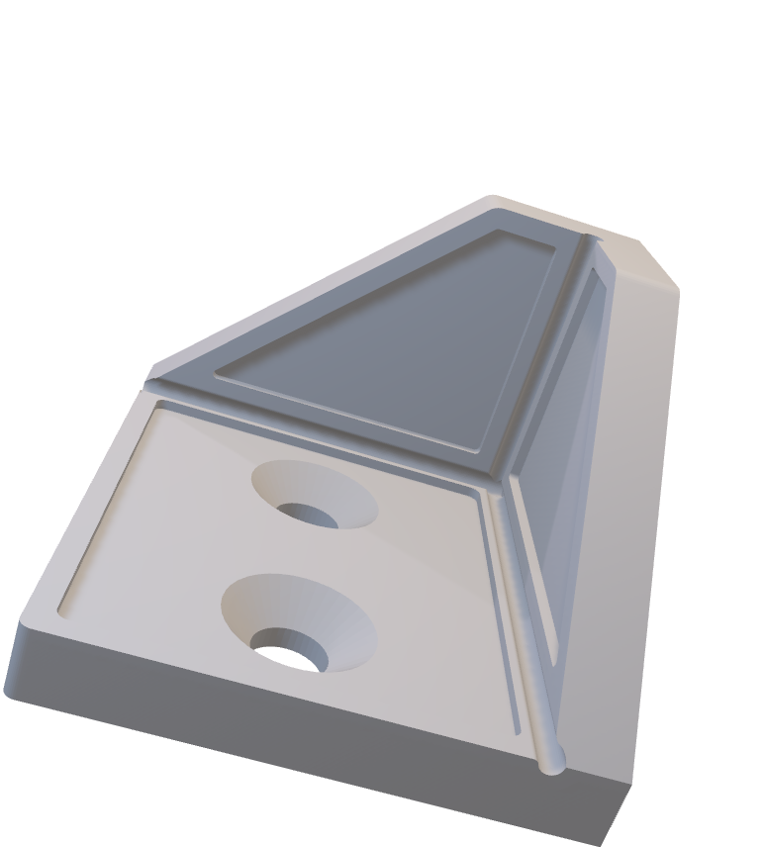
Holder

Slide 9
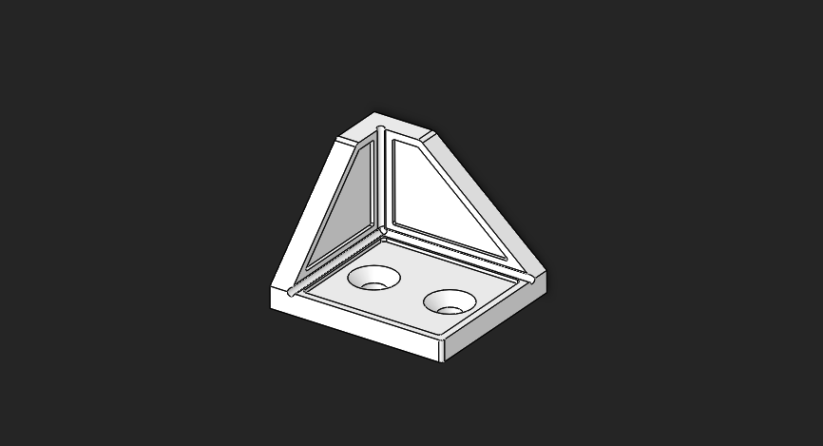
Anti-vibration foam
area

Slide 10
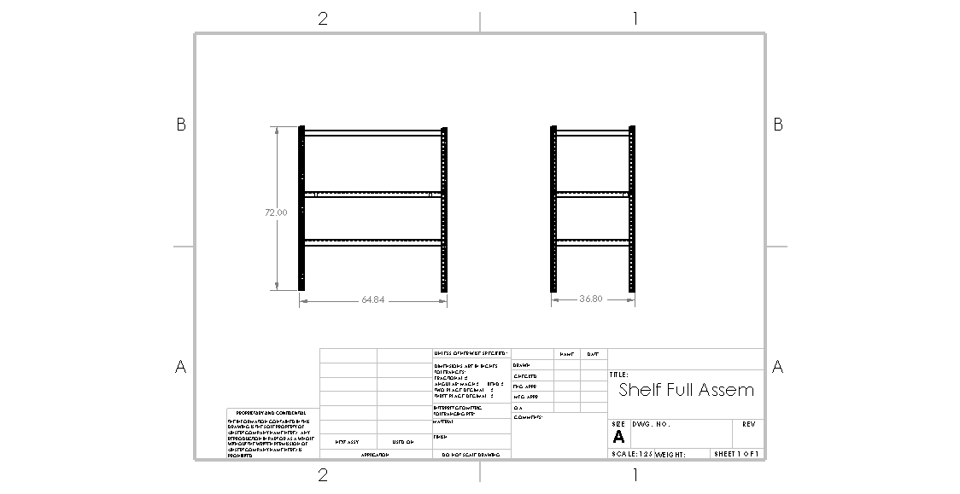

Slide 11
